Slide 1

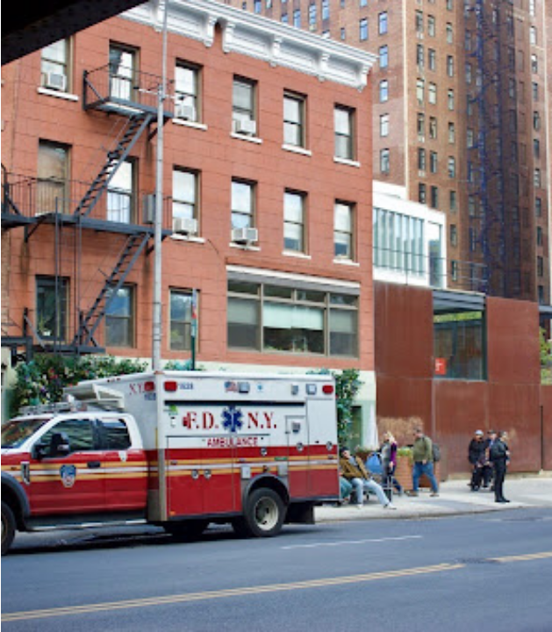
IBM Z Datathon: Theme 3 - Wildcard
PROJECT
DISPATCH
A solution to New York EMS response times.

Slide 2
THE PROBLEM
13 minutes
"PEOPLE ARE DYING BECAUSE THERE ARE NO STAFF,"
Anthony Almojera, a lieutenant paramedic recognising the ever increasing callout time.
AVERAGE URGENT CARE AMBULANCE RESPONSE TIME IN NEW YORK
"CLIMATE PROJECTIONS FOR NEW YORK CITY SHOWS SOME OF THE STATE’S LARGEST INCREASE IN EXTREME HEAT,"
Legacy infrastructure cannot handle the low staffing and high call volume especially in underserved boroughs.
Climate change is creating more drastic weather, which effects the most vulnerable people.
Notes:
Our Datathon Project: Project Dispatch aims to find a solution to the high ambulance response times in New York City. Worsening response times have caused a decrease by 2% of cardiac arrest revivals and therefore directly causing more deaths. We aim to solve this life or death situation.

Slide 3
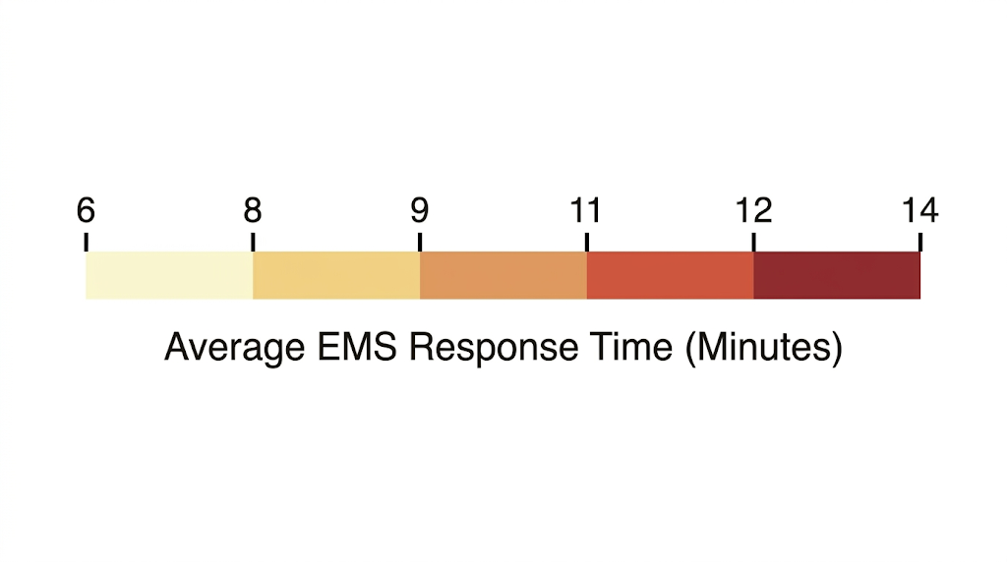
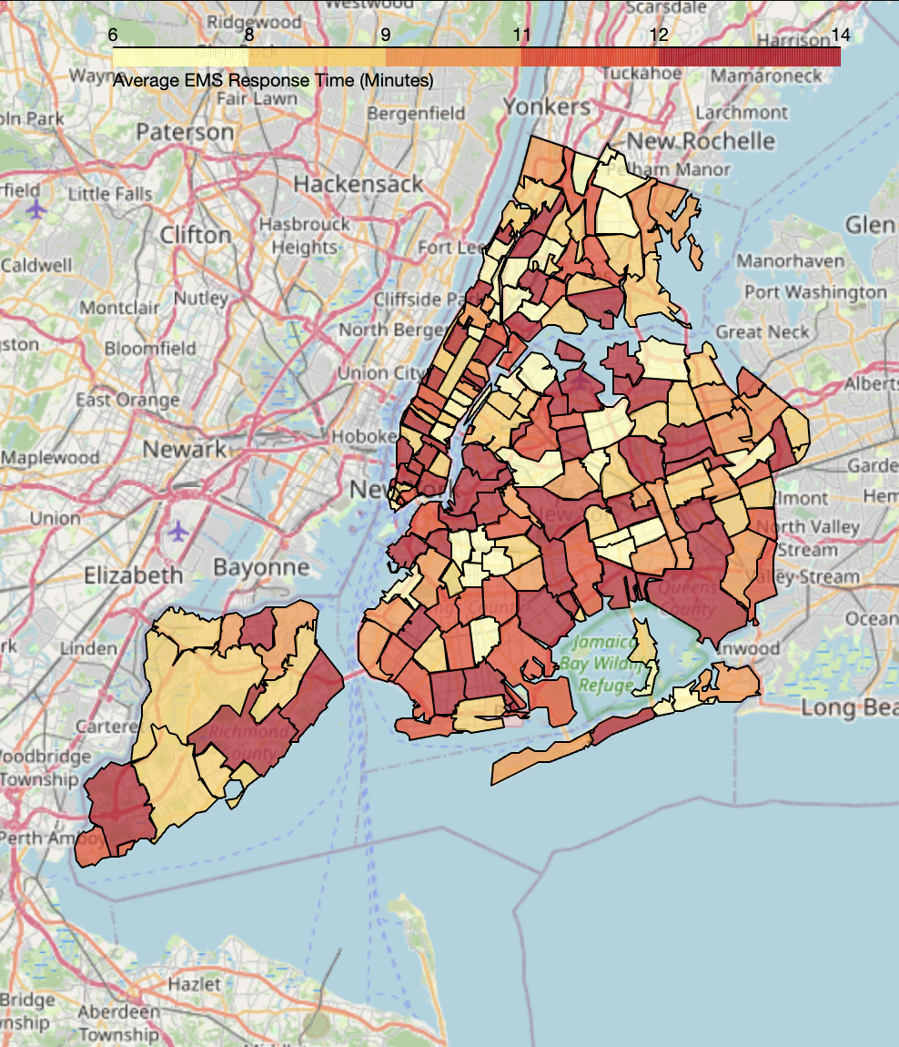
THE TARGET DEMOGRAPHIC
PRIMARY ADOPTION FOCUSED ON DENSE METROPOLITAN REGIONS. MODEL TRAINED ON NEW YORK CITY AS IT HAS THE LARGEST AND MOST INFORMATIVE DATASET AVAILABLE.
490,000
VEHICLES
8.8M
NYC POPULATION
Notes:
Why New York?
Most boroughs in new york have over 12 minute response time and there is a large data set from new york including cases many cases where ambulances took too long to respond.

Slide 4




THE SOLUTION
MOBILE MEDICAL UNITS
PREDICTIVE ROUTING
Dynamic route optimization across NYC. The optimised number of units has been calculated to 330.
Historical incident-based unit distribution.
INCIDENT PREDICTION
PRIORITY LOCATIONS
Weather-triggered preventative medical deployment.
EMS dispatch data hotspot mapping.
Notes:
To solve this problem, we have used AI to predict where incidents will occur so that emergency services can send lightweight vehicles to areas with a high chance of an incident occurring.
Why 330? About 4600 calls a day times about an hour per job equals 190 busy units on average with 200 - 300 units the simulation is overloaded at 400+ the static layout already reaches about 88% of critical calls in 8 minutes. But 330, gives about 71% providing a beneficial support net without leading to diminishing marginal returns to keep costs lower.

Slide 5
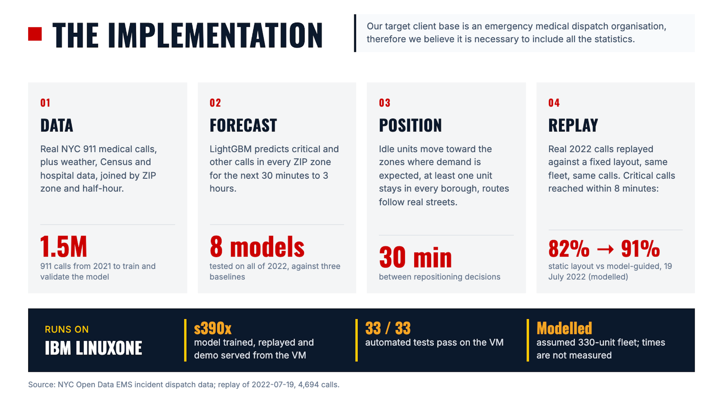
THE IMPLEMENTATION
Our target client base is an emergency medical dispatch organisation, therefore we believe it is necessary to include all the statistics.

Slide 6
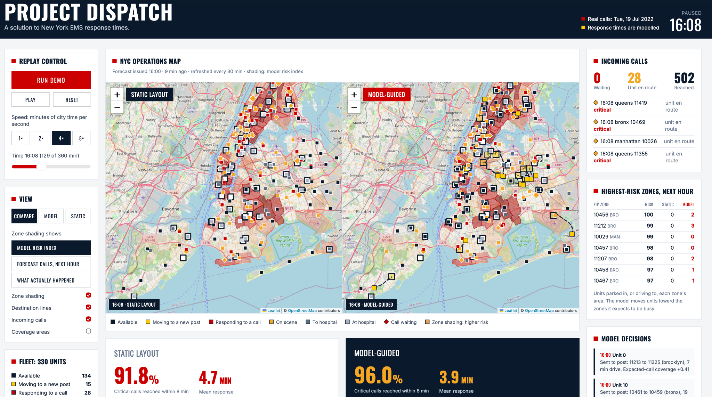
THE DEMO
DISPATCH_SYSTEM_V2
USER INTERFACE

Slide 7
THE COMPETITIVE ADVANTAGE
LEGACY SOLUTIONS
PROJECT DISPATCH
13 MIN
9.65 MIN
Mean response time.
Mean response time.
90% of critical calls reached in 8 minutes.
Improved coverage in underserved areas.
Static, reactive deployment.

Slide 8
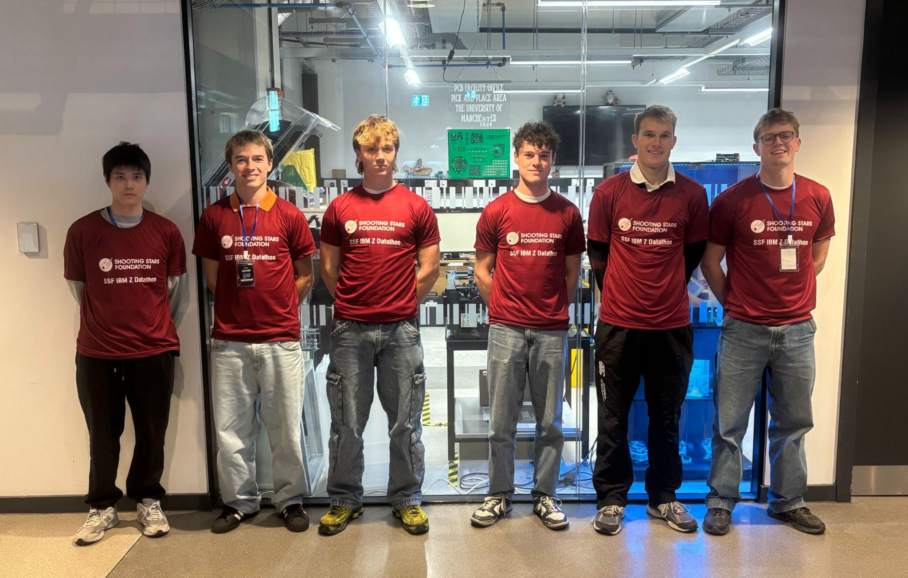
THE TEAM
NAPAT CHOLLABUD
DATA ENGINEER
FREDERIC TATHAM
MAINFRAME ANALYST
DARRAGH COLEMAN
DATA ENGINEER
HARRY ROWLANDS
DATA SCIENTIST
DOMINIC EASTON
BUSINESS ANALYST
JACOB BARTON
DATA ANALYST

Slide 9
THE FUTURE
BUILDING THE NEXT STANDARD OF URBAN RESPONSE.
Questions & Discussion
jacob.barton@student.manchester.ac.uk
darragh.coleman@student.manchester.ac.uk
harry.rowlands@student.manchester.ac.uk
dominic.easton@student.manchester.ac.uk
napat.chollabud@student.manchester.ac.uk
frederic.tatham@student.manchester.ac.uk

